Slide 1
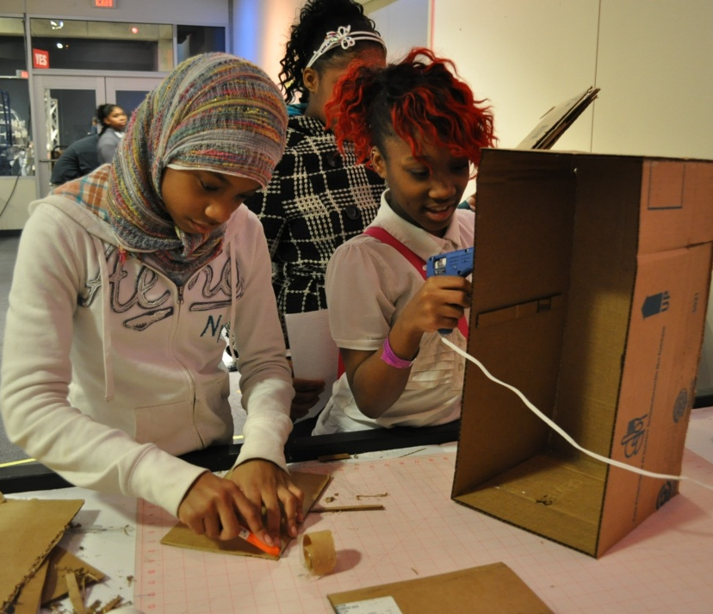
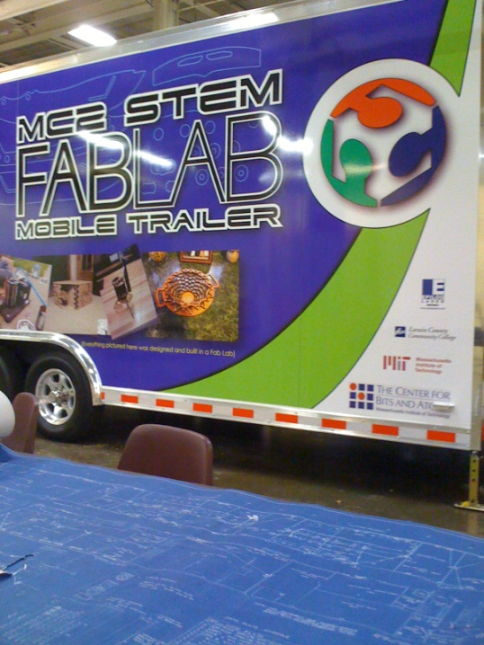
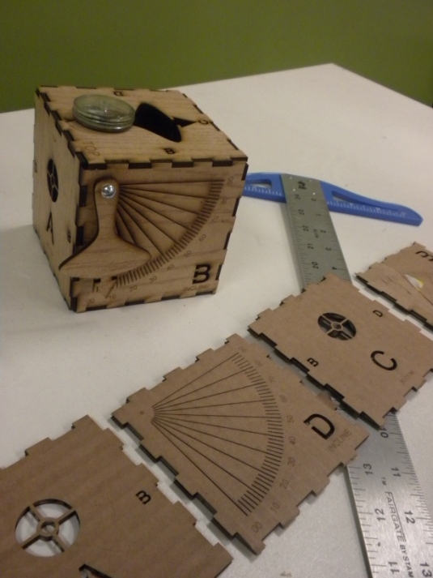
Capstone Projects
K-8 Curriculum
Mobile
FABLAB
Notes:
Welcome
Introduction to MC2 STEM
STEM Curriculum
FABLAB

Slide 2
9th Grade
Great Lakes Science Center
Downtown Cleveland
Exposure to exhibits
Partnerships
NASA
FABLAB
Situated on Great Lakes
10th Grade
General Electric (GE) Lighting and Industries Headquarters
Tutoring & Mentorships
Sophomore Engineering & Design Project
First Industrial park started by Thomas Edison
FABLAB
11th & 12th Grade City of Cleveland as Campus
Community / Business Internships
College Level Classes
Real world experiences
FABLAB
City, State, Country wide exposure
Local K-8 Curriculum and Implementation
Mobile FABLAB:
Notes:
Explain motive behind three sites, the investment from partners and its impact locally
Building on partnerships,
community exposure
communication skills
responsibility

Slide 3
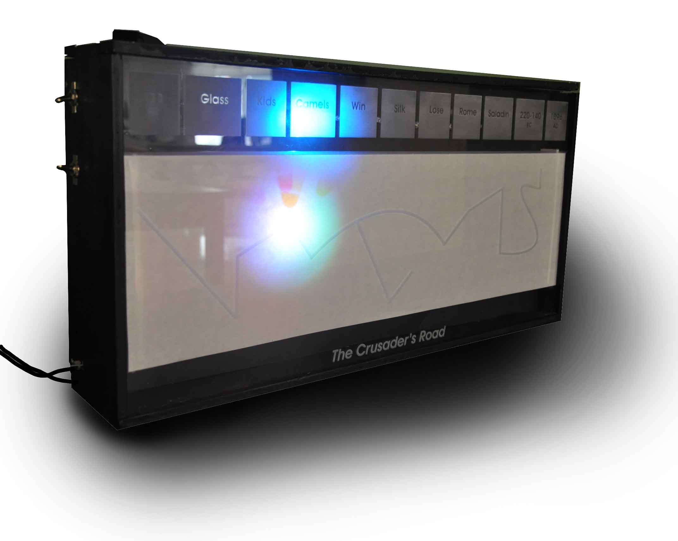
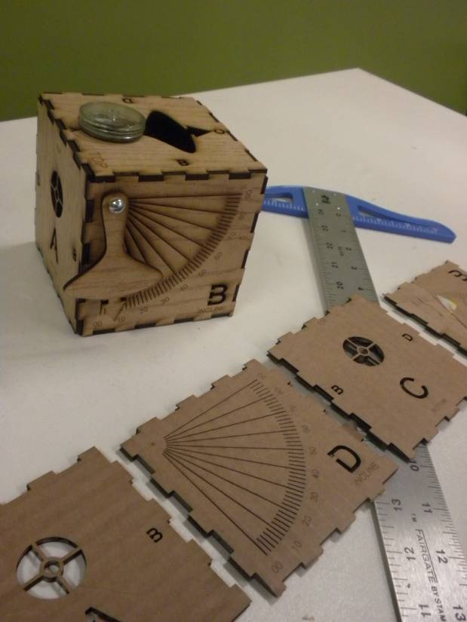
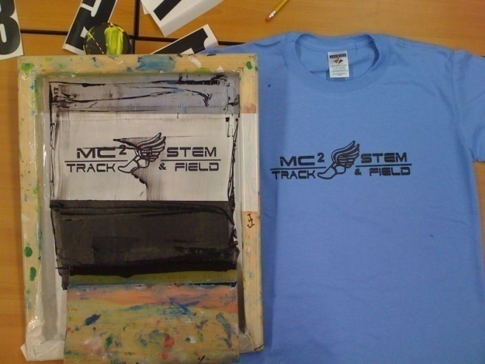
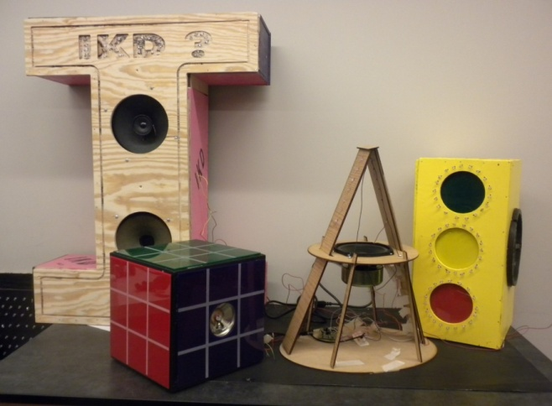
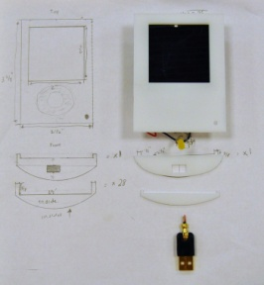
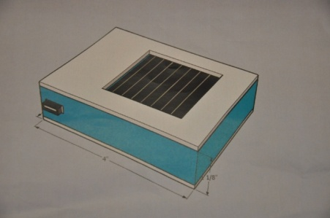
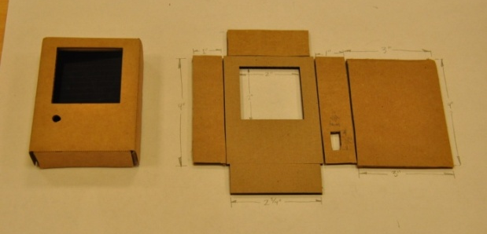
Capstone Projects

Slide 4
STEM Pedagogy
Trans-disciplinary approach to content deployment
SCIENCE, TECHNOLOGY, ENGINEERING, MATH
Humanities: Arts, Foreign Language, Socials Studies
Project / Problem Based
Mastery Assessed (Benchmark Alignment)
Framed by the Greater Cleveland Context

Slide 5
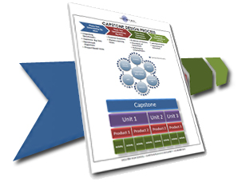
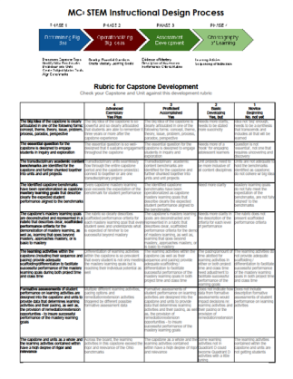
CAPSTONE Design
Trans-disciplinary approach to content deployment
Phase One: Determining Big Ideas
Phase Two: Operationalizing Big Ideas
Capstone Topic
Benchmark Alignment
Project Based Units
Essential Questions
Mastery Learning Goals
Phase Three: Assessment Development
Evidences of Mastery
Description of Assessment
Performance Criteria/Rubric
Phase Four: Choreography of Learning
Learning Activities
Sequencing of Instruction

Slide 6
Determining Big Idea
Phase Two: Operationalizing Big Ideas
Phase Three: Assessment Development
Phase Four: Choreography of Learning
Phase One: Determining Big Ideas
1A
Unpacking Benchmarks
Review Scope & Sequence
Familiarize yourself with benchmarks
Capstone Big Idea
Identify relevant and natural connections between subject areas
Brainstorm capstone themes, products and potential partnerships
Benchmark Alignment
Connect the capstone themes, products and partnerships with the benchmarks
Project Based Units
Brainstorm major themes for capstone units
1B
Phase One: Determining Big Ideas
Phase Two: Operationalizing Big Ideas
Capstone Big Idea
Benchmark Alignment
Project Based Units
Essential Questions
Mastery Learning Goals
Phase Three: Assessment Development
Evidences of Mastery
Description of Assessment
Performance Criteria/Rubric
Phase Four: Choreography of Learning
Learning Activities
Sequencing of Instruction
Unpacking Benchmarks
1C
1D

Slide 7
Benchmark Alignment
Capstone BIG IDEA
SCIENCE
MATH
ENGINEERING
ENGLISH
ART
SOCIAL STUDIES
National / State Benchmarks
Phase One: Determining Big Ideas
Phase Two: Operationalizing Big Ideas
Phase Three: Assessment Development
Phase Four: Choreography of Learning

Slide 8
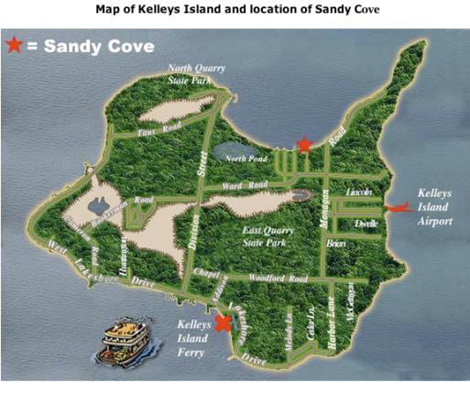
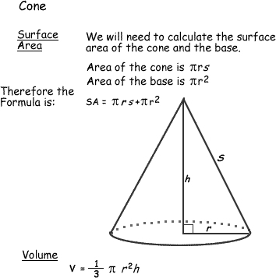
Rockets & Robots
The Bird Finder is a tool conventionally used to measure the angle of inclination one must look to identify "birds" (satellites orbiting the earth) in the night sky. Usually equipped with a compass and plumb bob, an individual would obtain a directional vector by which they could chart their readings. This standard design has been both fine tuned and elaborated upon for greater efficiency, durability, and assembly ease by ninth grade students using the FABLab.

Slide 9
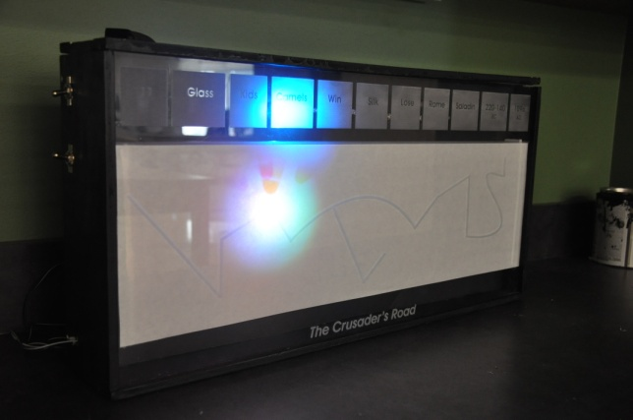
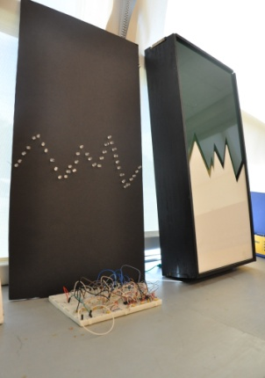
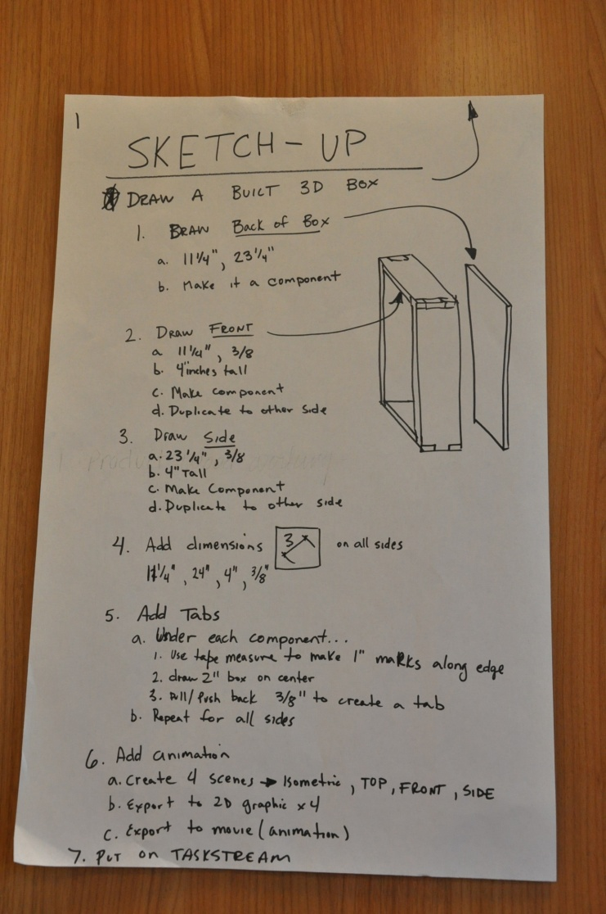
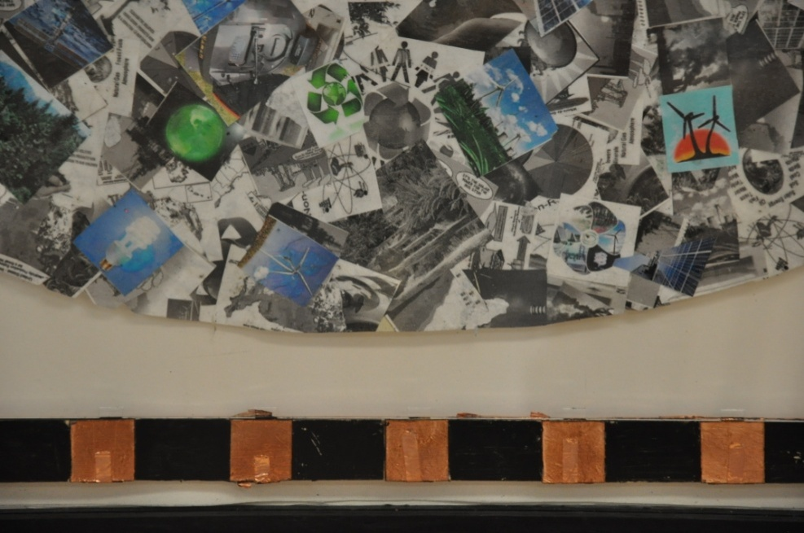
Light

Slide 10
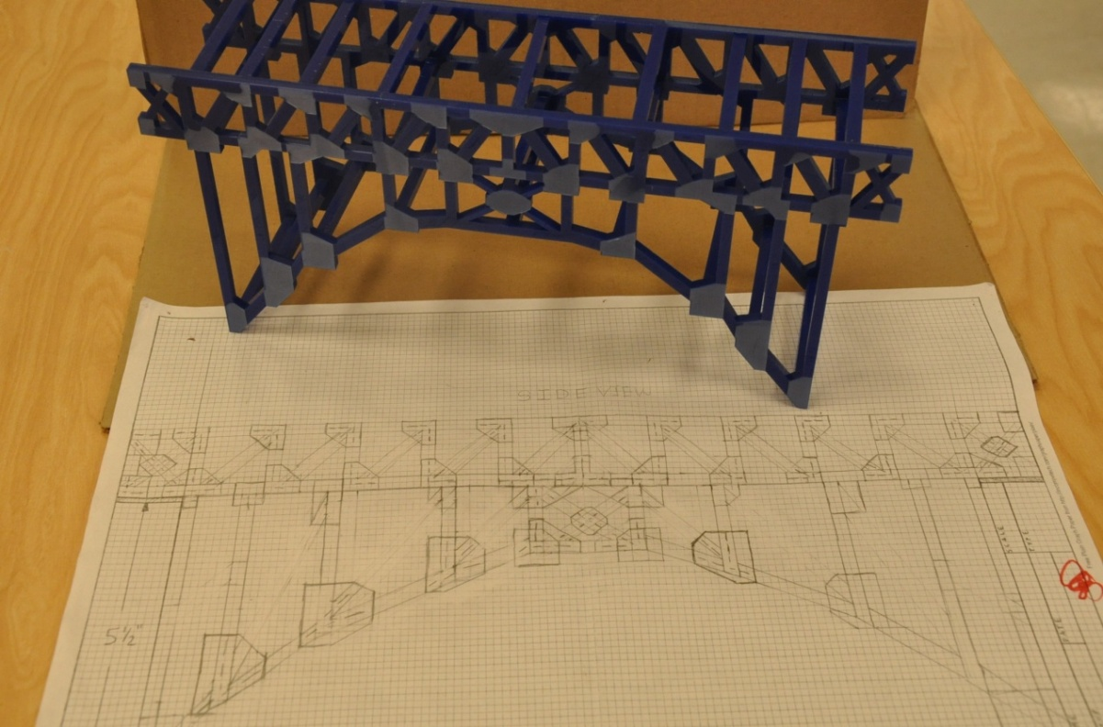
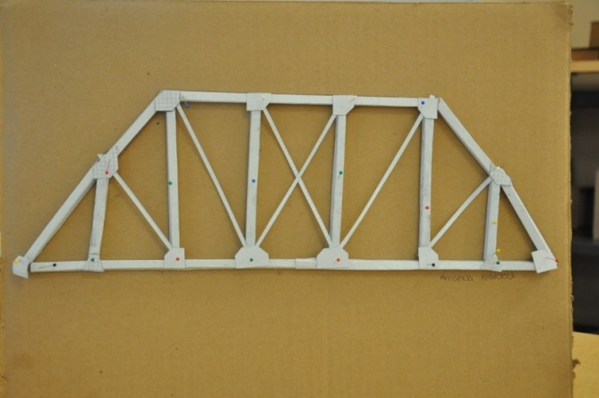
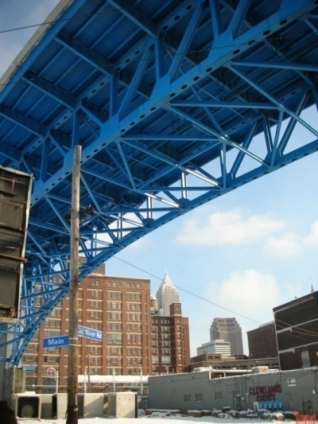
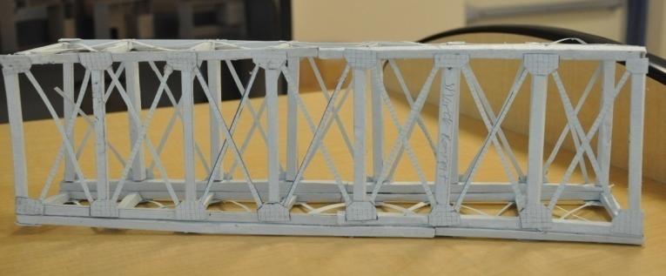
Bridges

Slide 11
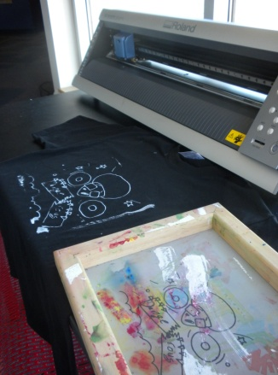
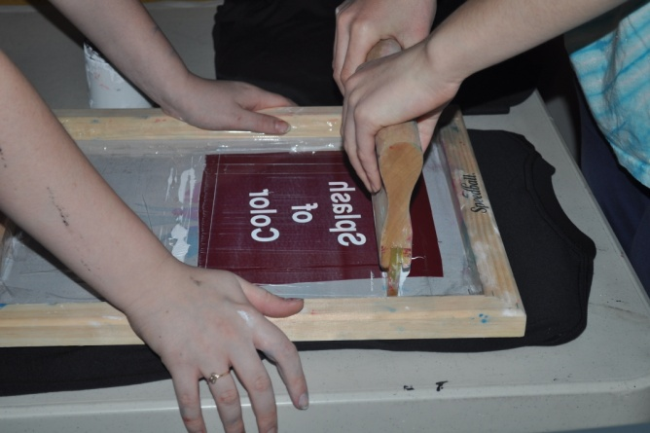
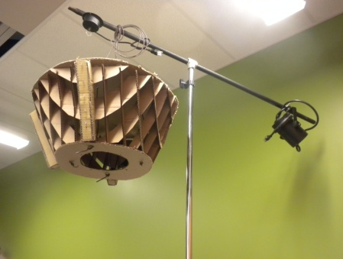
Communication

Slide 12
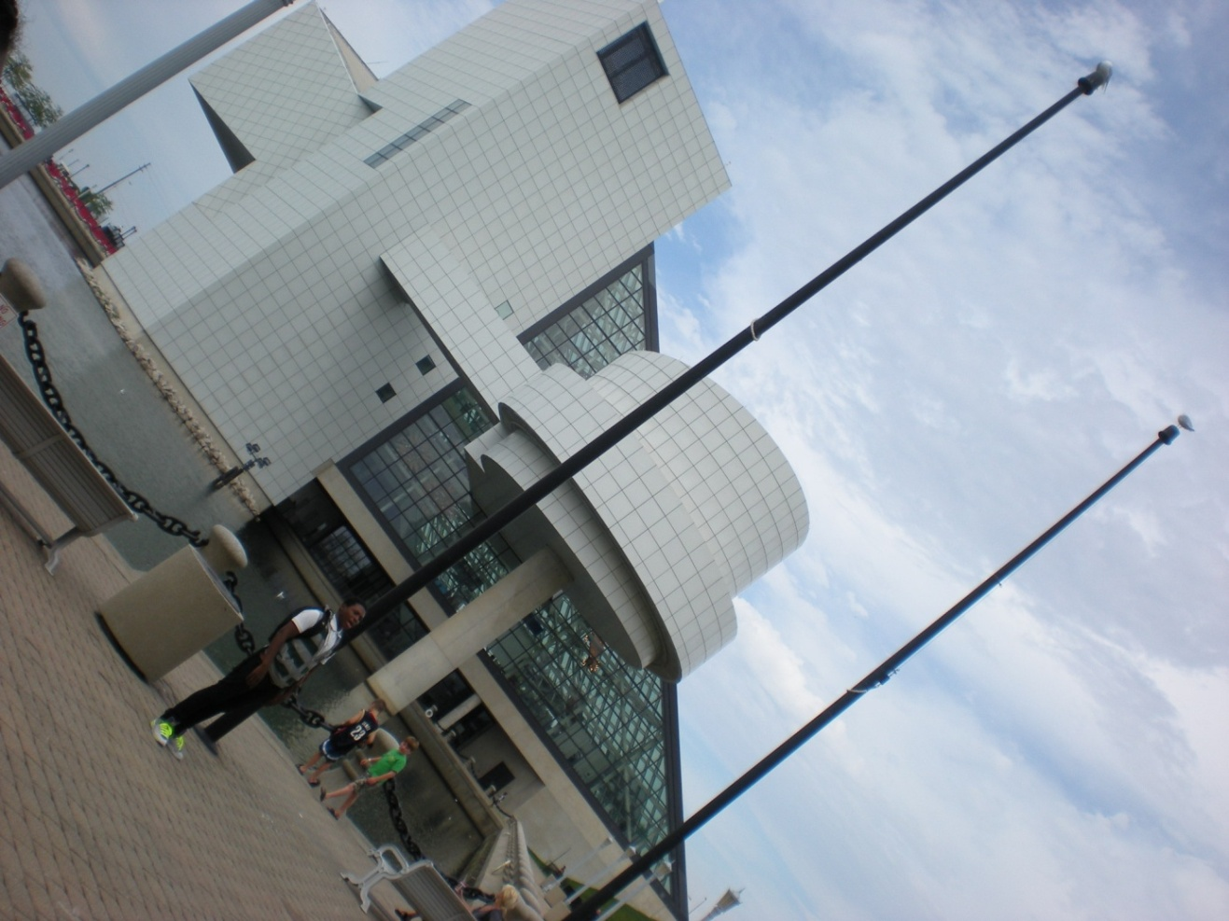
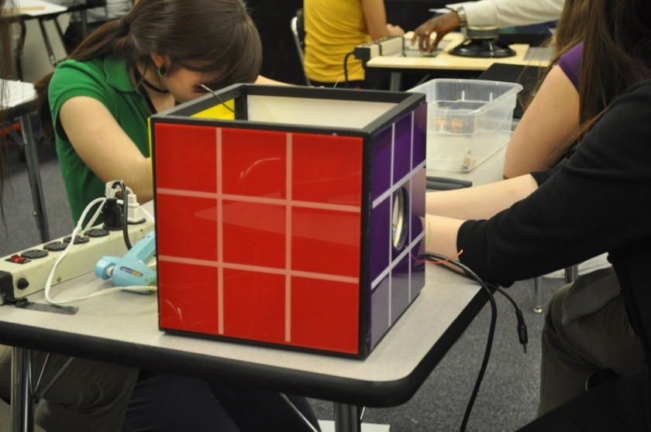
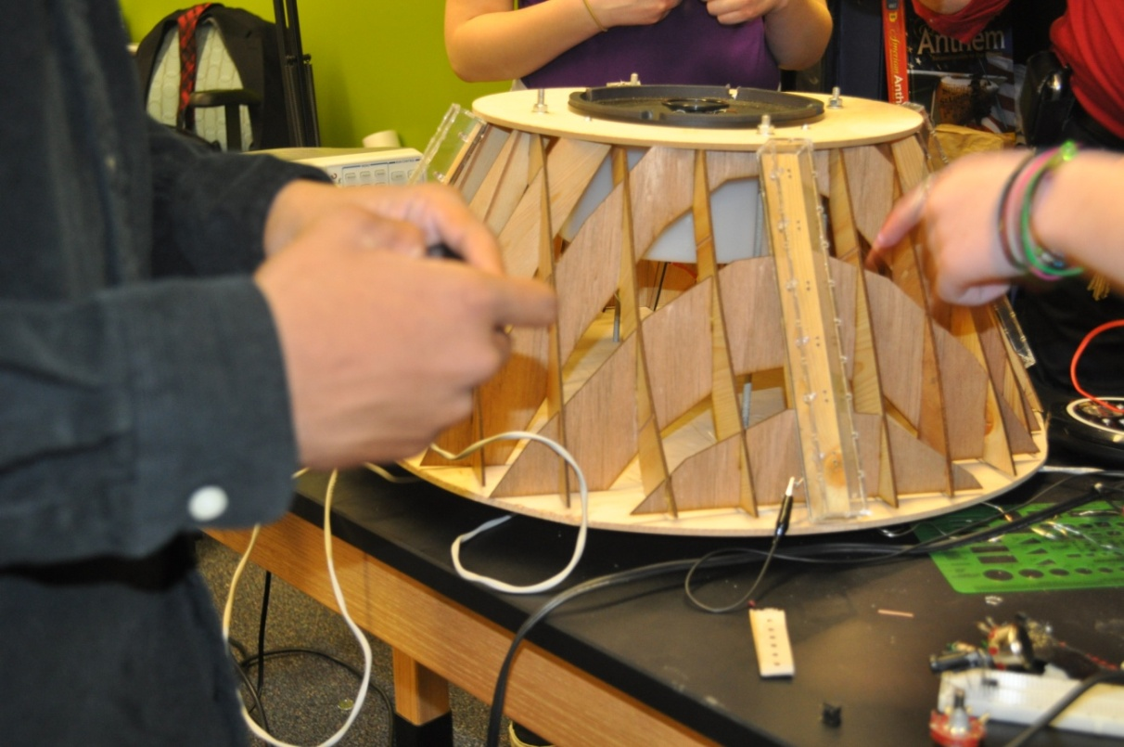
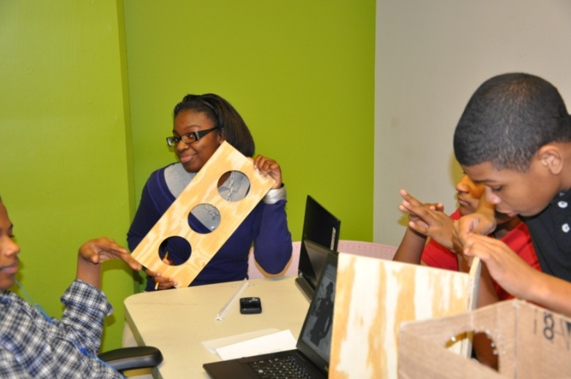

Slide 13
K-8 Trans-Disciplinary Curriculum
Teacher Development
STEM Approach(Science, Technology, Engineering, Math)
Grade level bands, school wide themes
District wide implementation
HANDS ON, tangible
Increased levels of interest and engagement
True demonstration of learning through inquiry, explanation, and discussion
Science Center Camps
Challenge!
Notes:
Explain motive behind three sites, the investment from partners and its impact locally
Building on partnerships,
community exposure
communication skills
responsibility

Slide 14
K-8 Trans-Disciplinary Curriculum EXAMPLES
Seasons of Change
Weather
Agriculture
Geography
Counting to charting
Art
Sustainable Community
Local resources
School gardens and green house
Patterns of movement
Farming
Economy
Notes:
Explain motive behind three sites, the investment from partners and its impact locally
Building on partnerships,
community exposure
communication skills
responsibility

Slide 15
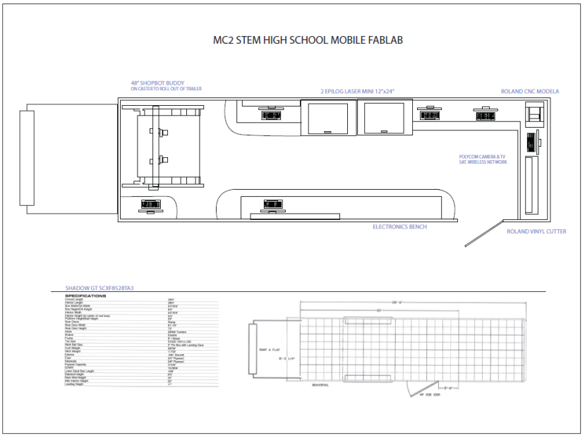
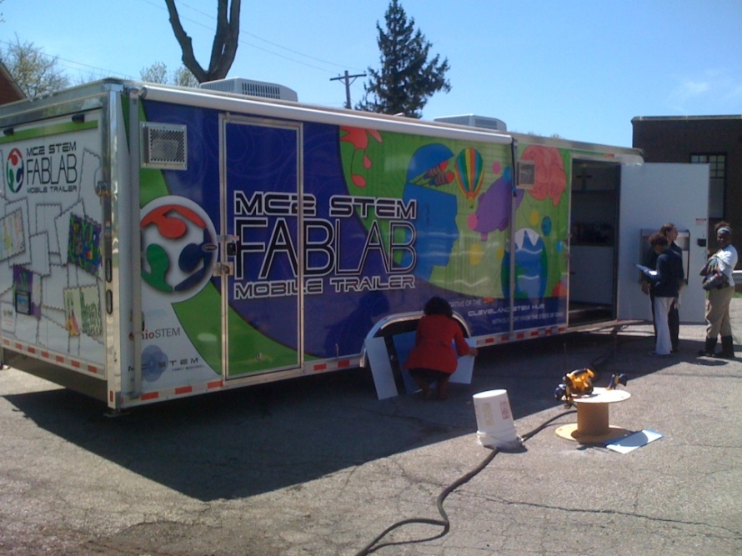
Mobile FABLAB
Grant Funded Outreach to District, City, Community, and Education
STEM Pedagogy
Increase DIY, Maker, Hacker awareness and network
Notes:
Explain motive behind three sites, the investment from partners and its impact locally
Building on partnerships,
community exposure
communication skills
responsibility

Slide 16
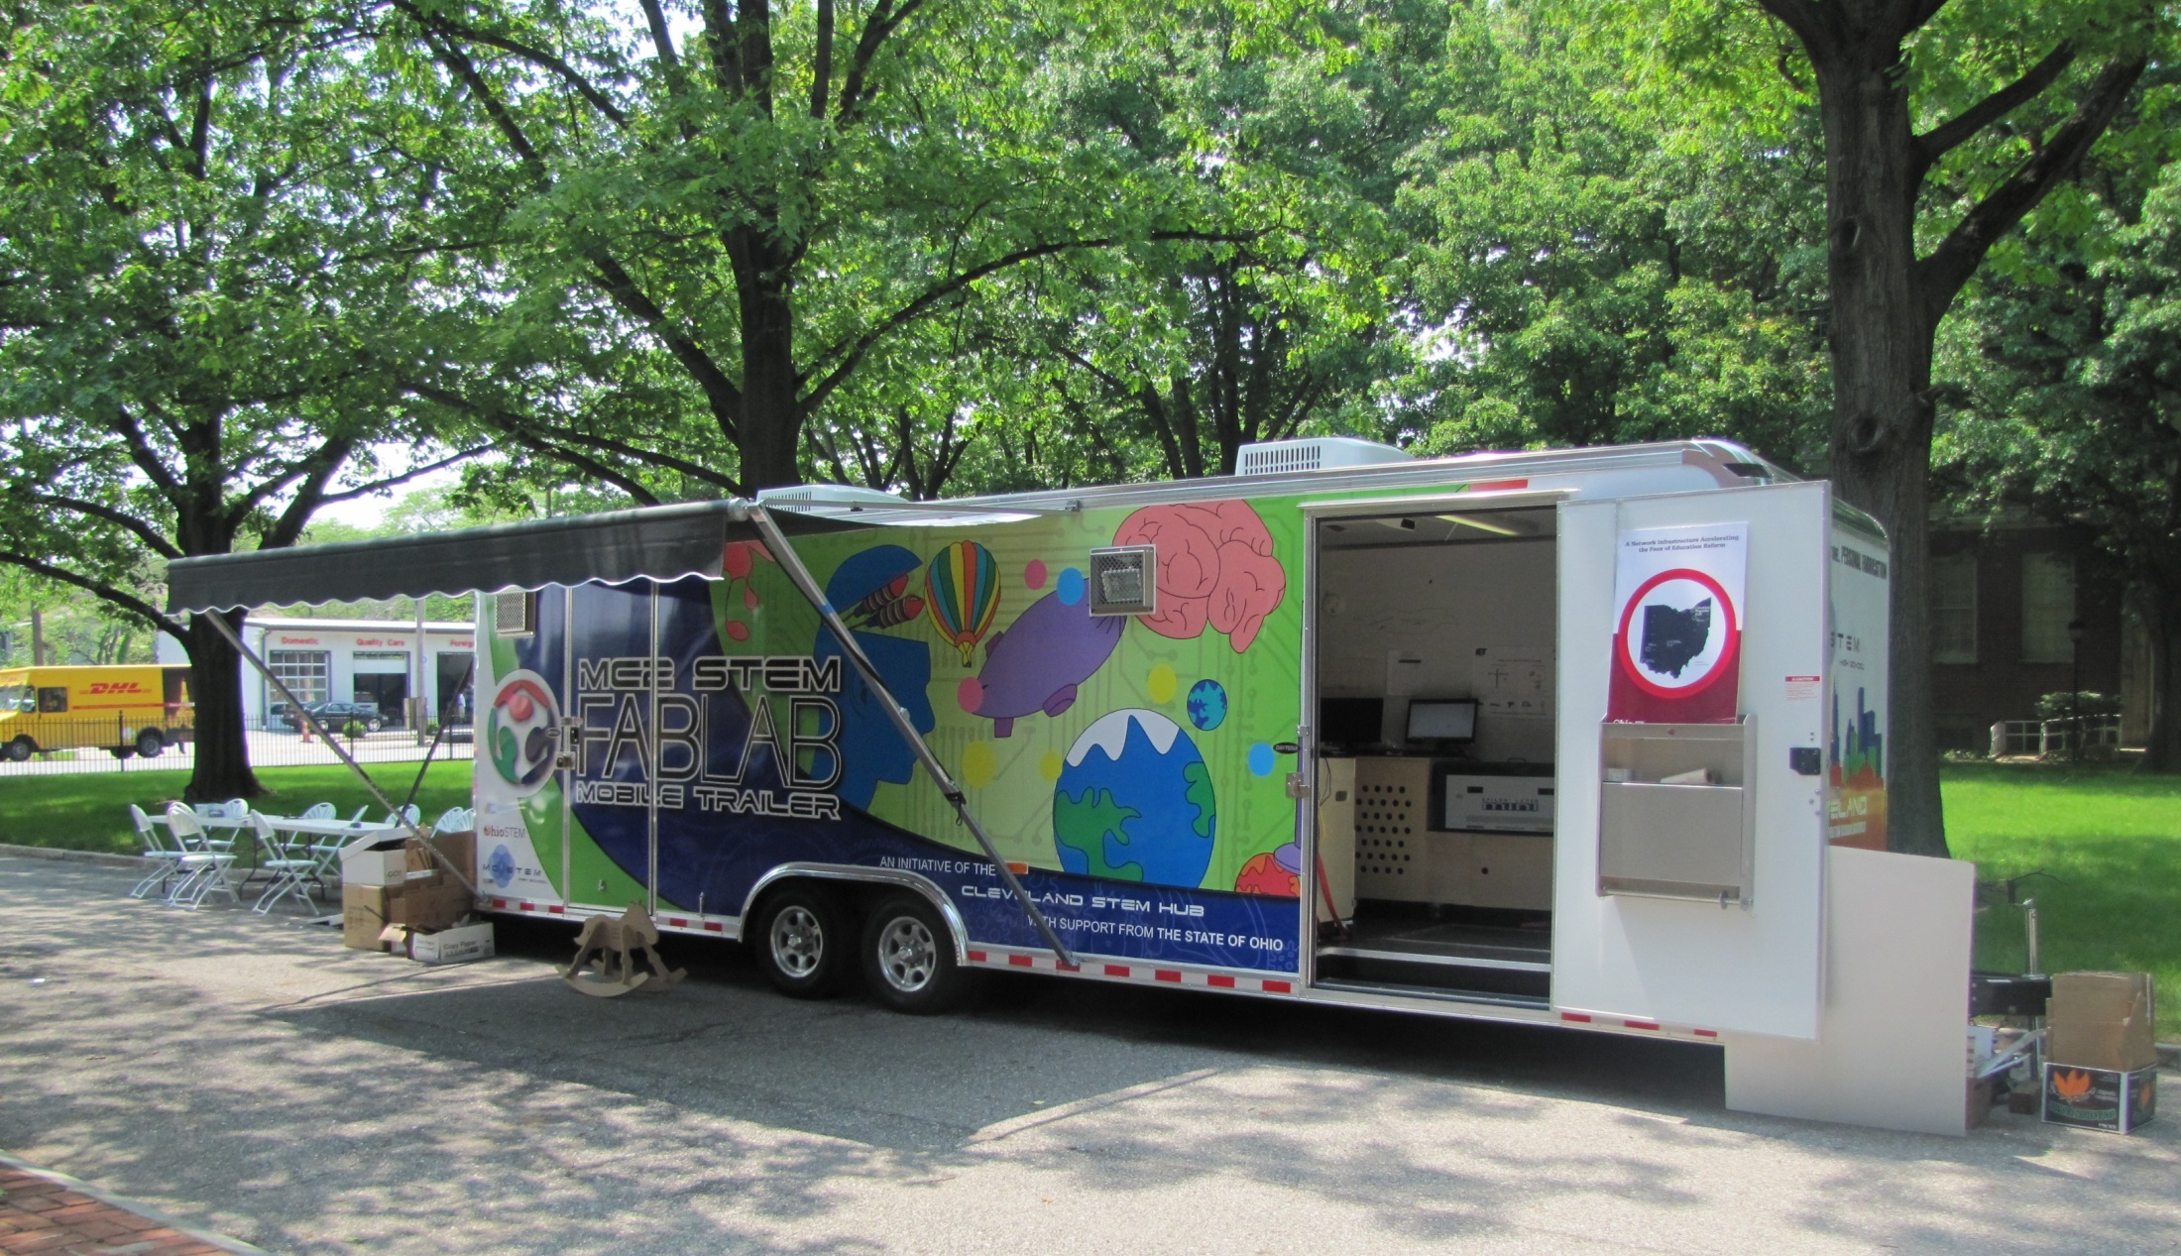
Mobile FABLAB
Notes:
Explain motive behind three sites, the investment from partners and its impact locally
Building on partnerships,
community exposure
communication skills
responsibility

Slide 17
Cleveland STEM
http://www.youtube.com/watch?v=JuXpZm2zzFo
Graham Ford Veysey North Water Partners

